Slide 1
The Interaction of Population Growth and Environmental Quality
Maureen Cropper and Charles Griffiths
Presentation by Hoyu Chong

Slide 2
Background
Natural resources impose a limit to economic growth. Population pressures reducing MPL as natural resources are exploited more intensely.
Result: low levels of income and environmental quality
Importance of environmental quality (measured by stocks of forests or by the absence of air/water pollution).
Environment is seen not as a factor that limits productivity but as a god whose quality is degraded by a growing population.
E.g. Population pressures cited as a cause of deforestation. Population growth leads to converting forests into arable lands or other uses.

Slide 3
Effects of Economic Growth and Modern Technology
Do economic growth and modern technology alleviate the problem of environmental degradation?
Countries with higher income witch to energy sources other than firewood and will use modern agricultural techniques that reduce the demand for agricultural land.
As for pollution, sanitation and waste water treatment will improve and pollution will be less of a problem at any level of population density.

Slide 4
Environmental Kuznets Curve
Environmental quality worsen up until approx $5,000 of per capita income and improving thereafter (Summers and Heston, 1991).
Rural population density and the rate of population growth shift the Kuznets curve for deforestation since these variables capture the effects of population pressures.

Slide 5
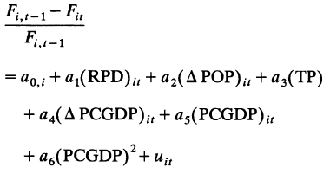
The Model
Notes:
F = forest area in country i in year t. RPD = rural population density. Delta Pop = percentage change in population. TP = timber price. Delta PCGDP = percentage change in per capita GDP. Note the diminishing marginal effect of PCGDP: logging and fuelwood uses o fforest likely to first increase with income and then decline, causing an inverted U-shape.

Slide 6
Data
Deforestation Data: Food and Agriculture Organization’s Production Yearbook (1993) on non-OECD countries in Africa, Asia, and Central and South America.
The parameters of the equation may vary across continents because the nature of forests varies significantly from one continent to another.
Population and PCGDP data: Summers and Heston (1991).
Data limited to only 64 countries and some years are missing for some countries (unbalanced panel data).
Data on price of tropical logs: FAO (1981, 1990)
Adjusted by the average mid-year market exchange rate for each country.
Ignores possible estimation bias caused by (hyper)inflation?

Slide 7
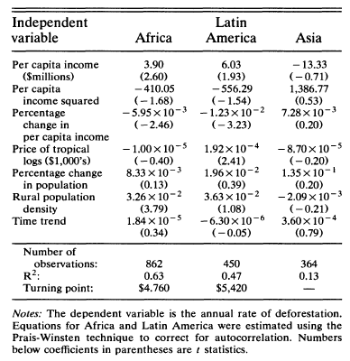
Fixed-Effects Model of Tropical Deforestation

Slide 8
Results
Only results for Africa and Latin America are statistically significant at conventional levels.
Splitting Asia into East Asia and South Asia does not improve the result.
A possible explanation is that although natural forest area in Asia decreased, however, a smaller hectares were planted, implying that the decrease in forest would actually be smaller (3.9 million hectares deforested – 2.1 million hectares planted = net decrease of 1.8 million hectares).
A hump-shaped relationship exists b/w per capita income and deforestation, and
For Africa, rural population density shifts this relationship upward
Price of tropical logs statistically significant only in Latin America
Increase in the rate of deforestation levels off as income increases
Increase in the price of tropical logs is likely to increase both destruction of natural forests and growth of plantations.

Slide 9
Conclusion
Income growth does not solve environmental problems.
In Africa, rural population density shifts the relationship between income and deforestation upward (higher density = higher deforestation rate)
Large implied trade-off between per capita income and rural population density
Cannot conclude that reducing the rate of population growth is the best method of reducing the rate of deforestation as market failure may be the actual root cause.
Due to poorly defined or enforced property rights, the private cost of deforestation is virtually zero.
Also for the same reason, people have no incentive to make efficient land-use decisions.

